Slide 1
Amazon Portfolio Dashboard
User choice on Paper book & Kindle Version
By Jaitri Taraphdar

Slide 2
Introduction
Introduction
Amazon dominates the book industry with both physical books and Kindle e-books.
The debate continues: Are Kindles replacing traditional books, or do paper books still hold their ground?
Let’s Find out with the help of Microsoft Power BI.

Slide 3
Rise of Kindle
Kindle offers convenience, portability, and affordability.
Features like adjustable fonts, built-in dictionaries, and night mode enhance reading.
Subscription services like Kindle Unlimited make e-books more accessible.
Paper Books’ Enduring Popularity
Many readers prefer the tangible feel, scent, and experience of physical books.
Paper books are easier on the eyes, don’t require charging, and allow for physical annotations.
Book lovers and collectors value printed editions as sentimental or aesthetic pieces.

Slide 4
Problem statements
Total No. of Buyers
Total No. of Sold Books
Total books sold by location
Sum of age by Gender
Sum of Age by location and gender
Sum of Purchase frequency by book category and kindle Model
Sum of Purchase frequency and Book category

Slide 5
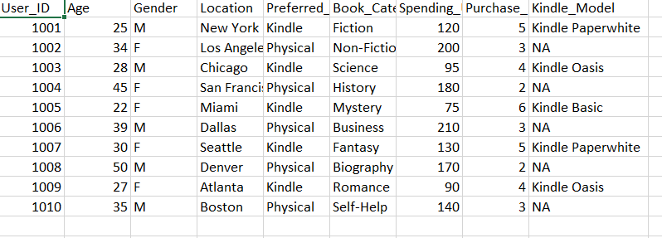
Analysis:
1. Data Collection:
Here a small dataset has been gathered by using ChatGPT and AI considering few components like age, preferred genre and Gender and many more.

Slide 6
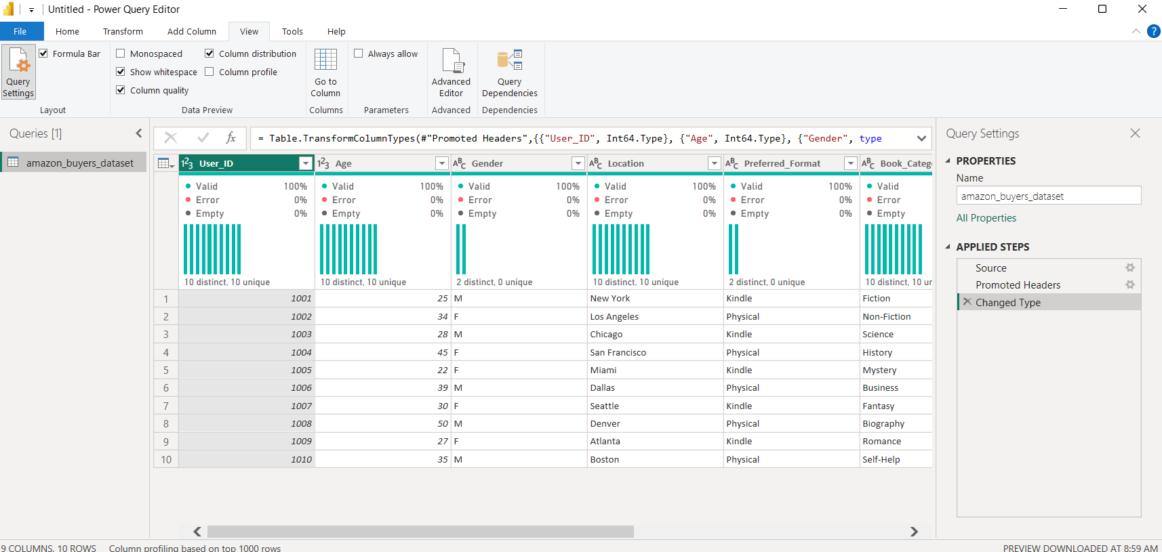
2. Data Cleaning:
As the Data was gathered with the help of AI, the data cleaning was not needed (has already checked the quality of the data with Power BI)

Slide 7
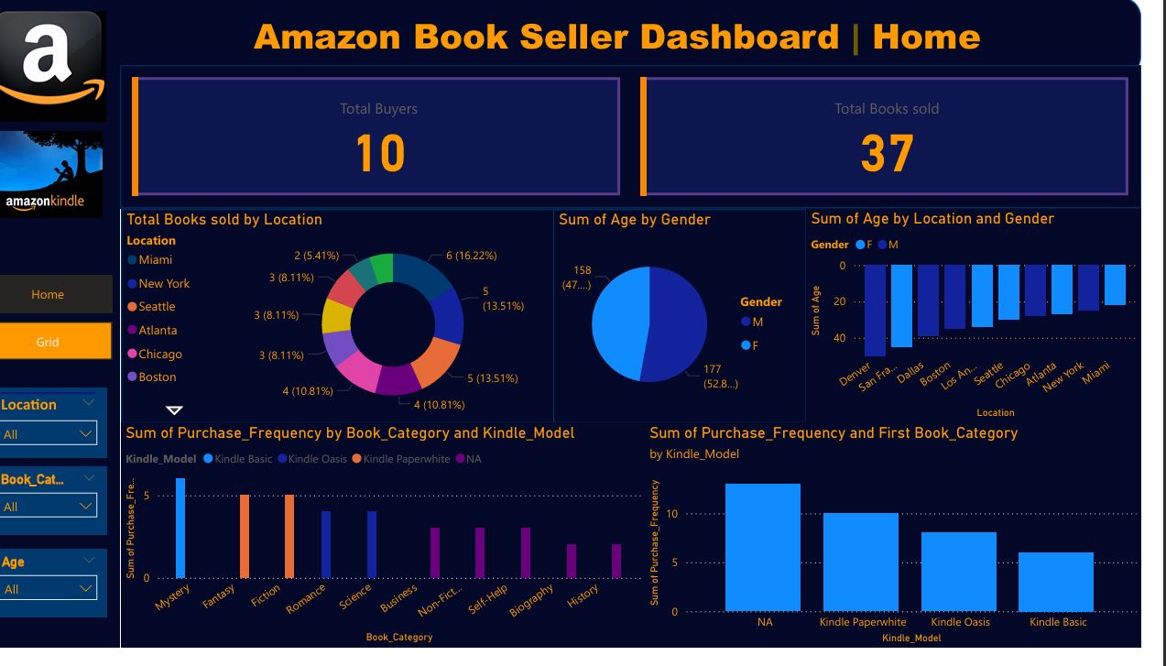
Data Presentation on Dashboard:

Slide 8
Market Trends:
Kindle and e-books are growing in digital adoption, especially for casual and academic reading.
Paper books still sell well, with many bestsellers seeing strong physical sales.
Hybrid readers use both formats, depending on convenience and preference.
Conclusion:
While Kindle and digital books are on the rise, paper books remain irreplaceable.
Amazon continues to profit from both formats, catering to different reader preferences.
The future is likely a balance between tradition and technology in the reading world.

